Slide 1

Proteus: Distributed machine learning task scheduling based on Lyapunov optimization
Yongan Xiang
Xi’an Jiaotong University

Slide 2
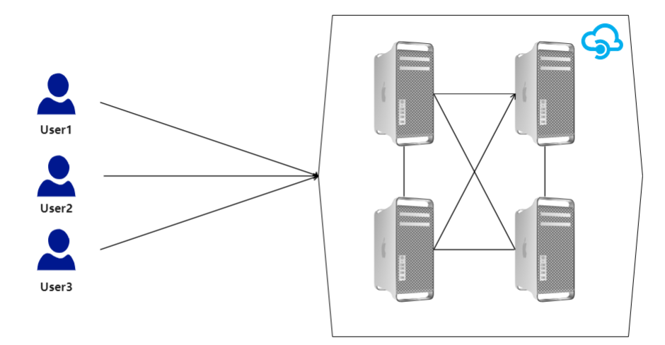
Cloud computing environment
Public availability
Service-oriented
Resource limitation
Notes:
云集群环境特点展示

Slide 3
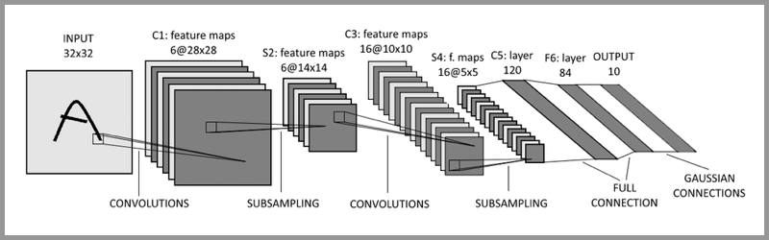
Characteristics of machine learning tasks
Repeatability
Big data volume
Independent calculation
Notes:
机器学习任务特点

Slide 4
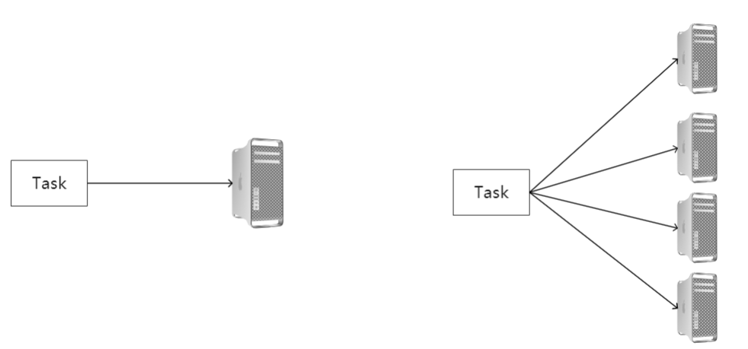
Scheduling strategy
or
Issues to consider
Whether the task is suitable for distributed
Whether the cluster environment allows for distribute
Notes:
调度策略展示

Slide 5
The problem solved by the paper
Is the machine learning task suitable for distributed?
In the case of limited cluster resources,
how to solve the relationship between
distributed scheduling and QoS
How Lyapunov's optimization method
is tried in machine learning
Notes:
论文解决的问题

Slide 6
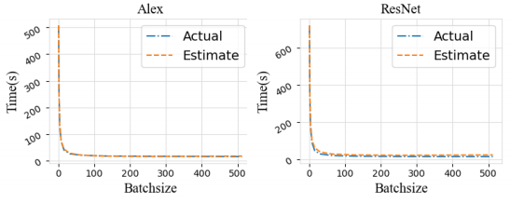
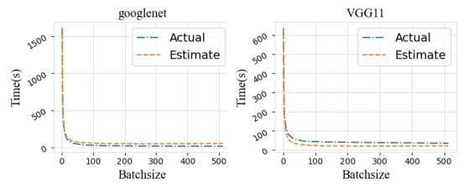
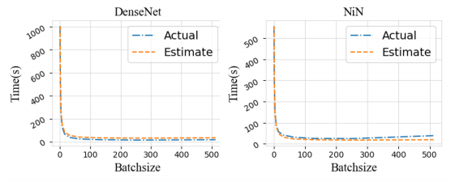
The relationship between normal model with batchsize
small batchsize case
The calculation time will decrease as the batchsize increases.
large batchsize case
Task calculation time will not be significantly reduced with the change of batchsize
Notes:
Batchsize—模型关系

Slide 7
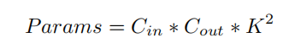
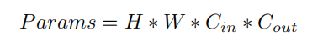
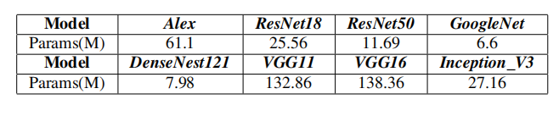
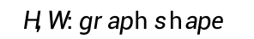
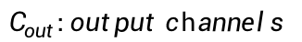
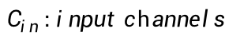
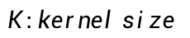
PARAMS OF MACHINE LEARNING MODELS
Convolutional layer
Fully connected layer
$$C_{in} :input channels$$
$$C_{out}:output channels$$
$$K :kernel size$$
$$H,W :graph shape$$
params of common machine learning models
Notes:
模型的params

Slide 8
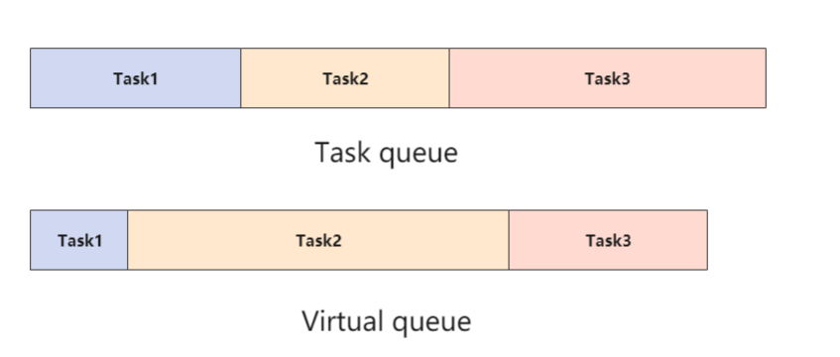
Queue design
Queue 1: The length of the task is based on the time it takes to actually run (static)
Queue 2: The length of the task is based on the waiting time of the task (dynamic)
Notes:
设置两条虚拟队列

Slide 9
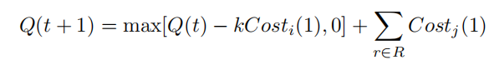
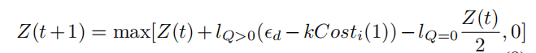
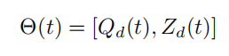
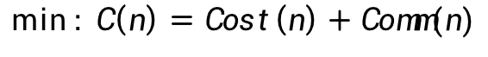
Formula Derivation
Target:
$$\min_{ }{: C\left(n\right)=Cost\left(n\right)+Comm(n)}$$
Task Queue ：
Virtual Queue ：
Since the two queues need to be considered at the same time, so we need to combined two queues formulas.
Notes:
公式推导1

Slide 10
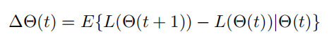
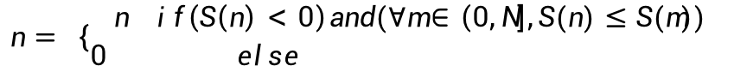

Formula Derivation
Every time slot :
Decision formula :
$$\min_{ }:{S\left(n\right)}=VE\left\{C\left(n\right)\right|θ(t)\}+ {\left(k{Cost}_{i}\left(1\right)\right)}^{2}−k{Cost}_{i}(1)\{Z\left(t\right)+Q(t)\}$$
Result :
$$n= \left\{\begin{aligned}n if\left(S\left(n\right)<0\right)and(∀m∈\left(0,N\right],S(n)≤S(m)) \\ 0 else \end{aligned}\right.$$
Notes:
公式推导2

Slide 11
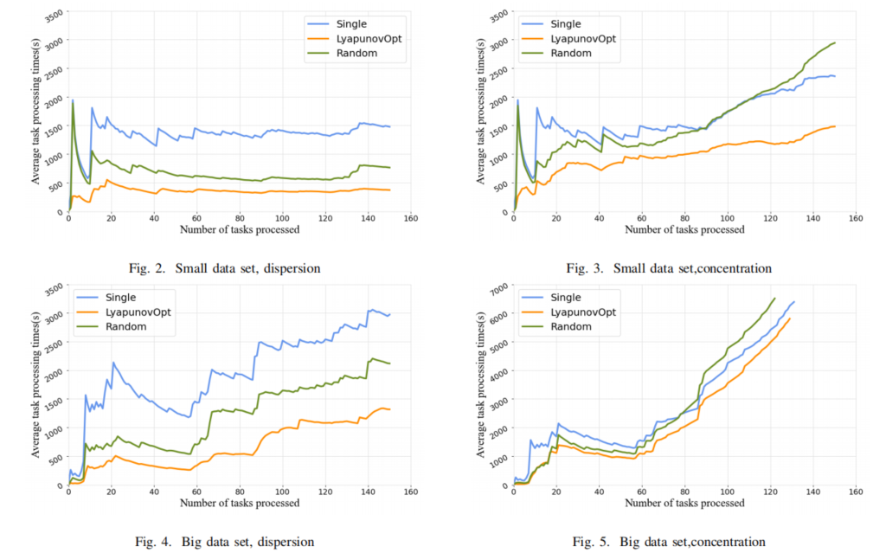
Experimental results
Notes:
数据结果展示

Slide 12
Thank you for listening

